Slide 1

PERFUME
WEBSITE
.1 HTML .2 CSS
.3 JAVASCRIPT
Notes:
全局英文字体：Arial
全局中文字体：微软雅黑
无用到特殊字体，建议使用微软OFFICE2013或2016演示，效果更佳
感谢你的购买
更多作品，请访问作者主页，为你职场助力。
售后服务QQ：835692134

Slide 2

CONTENT
INTRODUCTION
1
All about html , css & javascript
WHY I CHOOSE THIS PROJECT
2
all about intrest
MY WEB PAGE
3
contains home page , products , about us & contact
LEARING OUTCOME
4
what we learn and understand
Notes:
全局英文字体：Arial
全局中文字体：微软雅黑
无用到特殊字体，建议使用微软OFFICE2013或2016演示，效果更佳
感谢你的购买
更多作品，请访问作者主页，为你职场助力。
售后服务QQ：835692134

Slide 3
01
INTRODUCTION
Notes:
全局英文字体：Arial
全局中文字体：微软雅黑
无用到特殊字体，建议使用微软OFFICE2013或2016演示，效果更佳
感谢你的购买
更多作品，请访问作者主页，为你职场助力。
售后服务QQ：835692134

Slide 4
INTRODUCTION :- HTML
What it does
How it's stored
Defines the structure and content of web pages
In files with the .html or .htm extension
How it's displayed
How it's enhanced
A web browser reads the HTML in the files and displays it
Often used with CSS and JavaScript
How it works
What it's used for
Uses HTML elements, like tags and attributes, to mark up content
Creating web pages and applications
It is the standard markup language for creating web pages. It's used to structure content, like paragraphs,
headings, links, and images, on a web page.

Slide 5
INTRODUCTION :- CSS
It's a language used to describe the look and formatting of a website written in HTML.
CSS Can :
- Set colors, fonts, and sizes
- Create layouts
- Add spacing
- Make sites responsive
- Add animations and transitions
CSS supports responsive layouts that adapt to different screen sizes (mobile, tablet, desktop).
CSS allows you to apply the same styles across multiple pages with a single stylesheet.
①
②
③
4

Slide 6
INTRODUCTION :- JAVASCRIPT
Enhancing Interactivity
JavaScript makes websites interactive. Some examples:
- Image sliders/carousels
- Pop-up modals
- Show/hide content on button click
Dynamic Content Updates
With JavaScript, content on a page can update without reloading the entire page.
Animation and Effects
JS can be used to animate elements:
- Fading in/out
- Moving objects
- Changing styles over time

Slide 7
02
WHY I CHOOSE THIS PROJECT
Notes:
全局英文字体：Arial
全局中文字体：微软雅黑
无用到特殊字体，建议使用微软OFFICE2013或2016演示，效果更佳
感谢你的购买
更多作品，请访问作者主页，为你职场助力。
售后服务QQ：835692134

Slide 8
Why I Chose "Perfume" as the Topic
Unique & Personal Topic
exploring
Creating a perfume website helped me practice e-commerce elements, like product displays, buying it and doing payment done
Designing a website around perfume allowed me to explore a visually appealing and emotionally rich subject that connects with people on a deeper level.
Perfume has many varieties—floral, woody, spicy, etc.—and each type can inspire different colors, layouts, and moods on the site.
Many websites are made for tech, food, or fashion. Perfume is a less common but rich topic that stands out and reflects my personal interest.
Creative Freedom
Product-Based Design Practice

Slide 9
03
MY WEB PAGE
Notes:
全局英文字体：Arial
全局中文字体：微软雅黑
无用到特殊字体，建议使用微软OFFICE2013或2016演示，效果更佳
感谢你的购买
更多作品，请访问作者主页，为你职场助力。
售后服务QQ：835692134

Slide 10
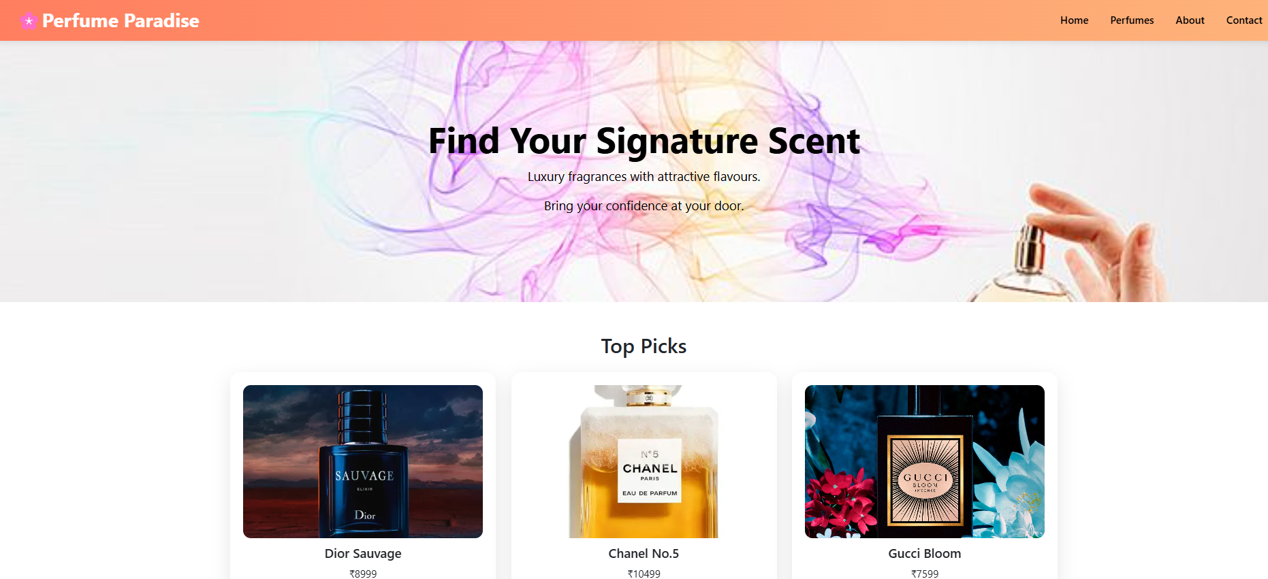
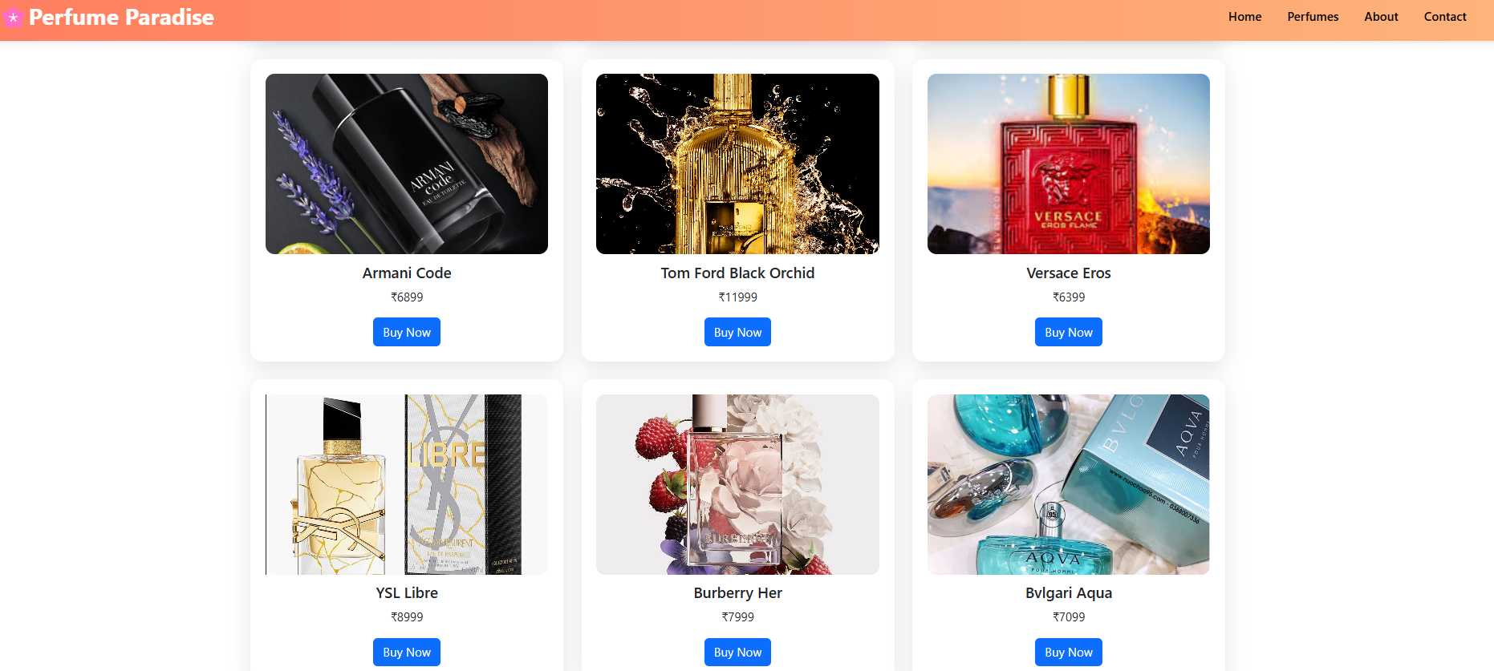
MY WEB PAGE
CONTAINS HOME PAGE
CONTAINS PRODUCT WITH RANGE

Slide 11
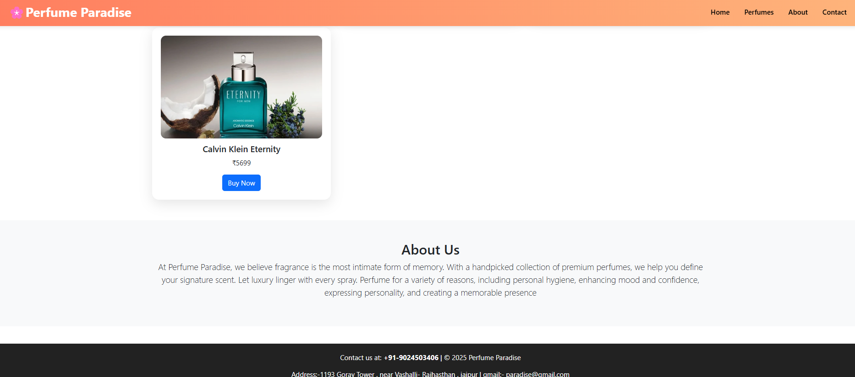
CONTAINS ABOUT US AS WELL AS CONTACT

Slide 12
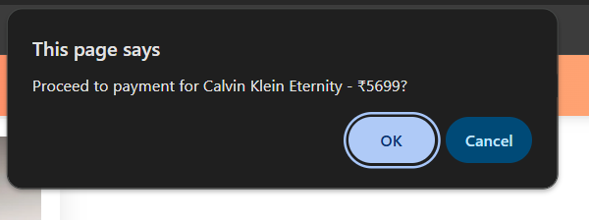
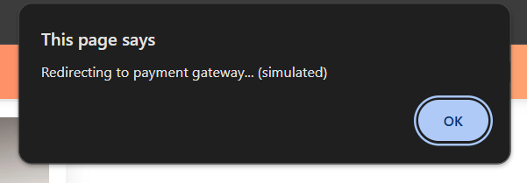
WHEN YOU CLICK (BUY NOW) THIS APPARES AND ASK YOUR PERMISSION TO PROCEED YOUR PAYMENT
WHEN YOU PROCEED FOR YOUR PAYMENT IT ASK YOU FOR REDIRECTING TO YOUR PAYMENT GATEWAY

Slide 13
04
LEARNING OUTCOME
Notes:
全局英文字体：Arial
全局中文字体：微软雅黑
无用到特殊字体，建议使用微软OFFICE2013或2016演示，效果更佳
感谢你的购买
更多作品，请访问作者主页，为你职场助力。
售后服务QQ：835692134

Slide 14
LEARNING OUTCOME
Improved understanding of how design choices affect user interaction and engagement
Problem-Solving & Debuggin
1
Mastered using HTML for content structure .
Practiced advanced CSS styling techniques
SUCCESS
User Interface (UI) & User Experience (UX) Design
Learned how to plan, structure, and design a website
Learned how to use browser developer tools effectively
Improved HTML & CSS Skills
Understanding the Web Design Process

Slide 15
THANKS
Notes:
全局英文字体：Arial
全局中文字体：微软雅黑
无用到特殊字体，建议使用微软OFFICE2013或2016演示，效果更佳
感谢你的购买
更多作品，请访问作者主页，为你职场助力。
售后服务QQ：835692134

